Slide 1

Jira Software
Jira Software for Scrum

Slide 2

Did you finish the Jira Software (Jira Software for Scrum) pre-class activity?
Notes:
🍐 This is a Pear Deck Multiple Choice Slide. Your current options are: A: I finished completely., B: I finished partially., C: No, I didn't finish.,
🍐 To edit the type of question or choices, go back to the "Ask Students a Question" in the Pear Deck sidebar.

Slide 3
Table of Contents
Creating Jira Software Cloud Free
Creating Projects
Working with Issues
Planning Sprints
Reports in Jira

Slide 4


Have you created your Jira Software Cloud site?
Notes:
🍐 This is a Pear Deck Multiple Choice Slide. Your current options are: A: Yes, B: No,
🍐 To edit the type of question or choices, go back to the "Ask Students a Question" in the Pear Deck sidebar.
Have you created your Jira Software Cloud site?

Slide 5
Creating Jira Software Cloud Free
1
Notes:
Now we will learn how to create a project on jira software
There are several ways of creating project on jira software
First of all when you set up jira software cloud first time
you also create a project.

Slide 6
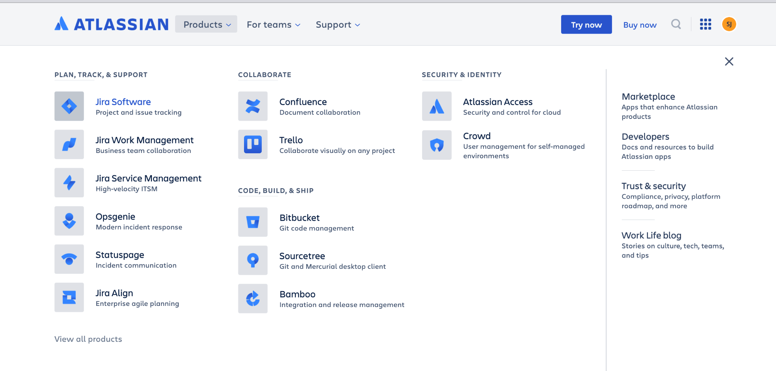
Creating Jira Software Cloud
Notes:
From atlassian landing page on top there is products menu
from this menu you can select which atlassian product you use.
As we will use jira software we will select that one of course

Slide 7
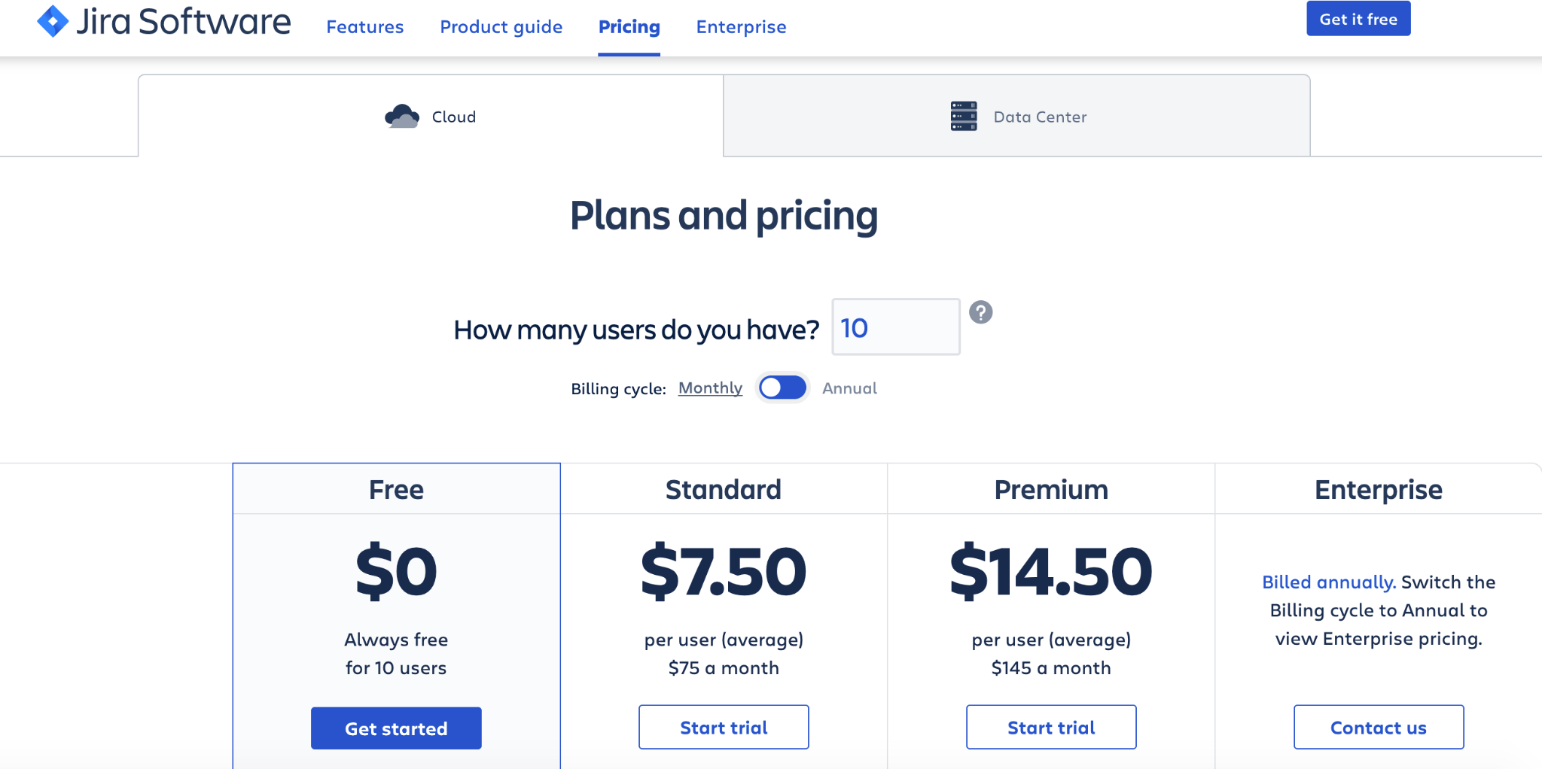
Creating Jira Software Cloud
Notes:
and than go to pricing and it wil give us some options
if you are a big company you can select premium or enterprise options
But for us free one is ok.

Slide 8
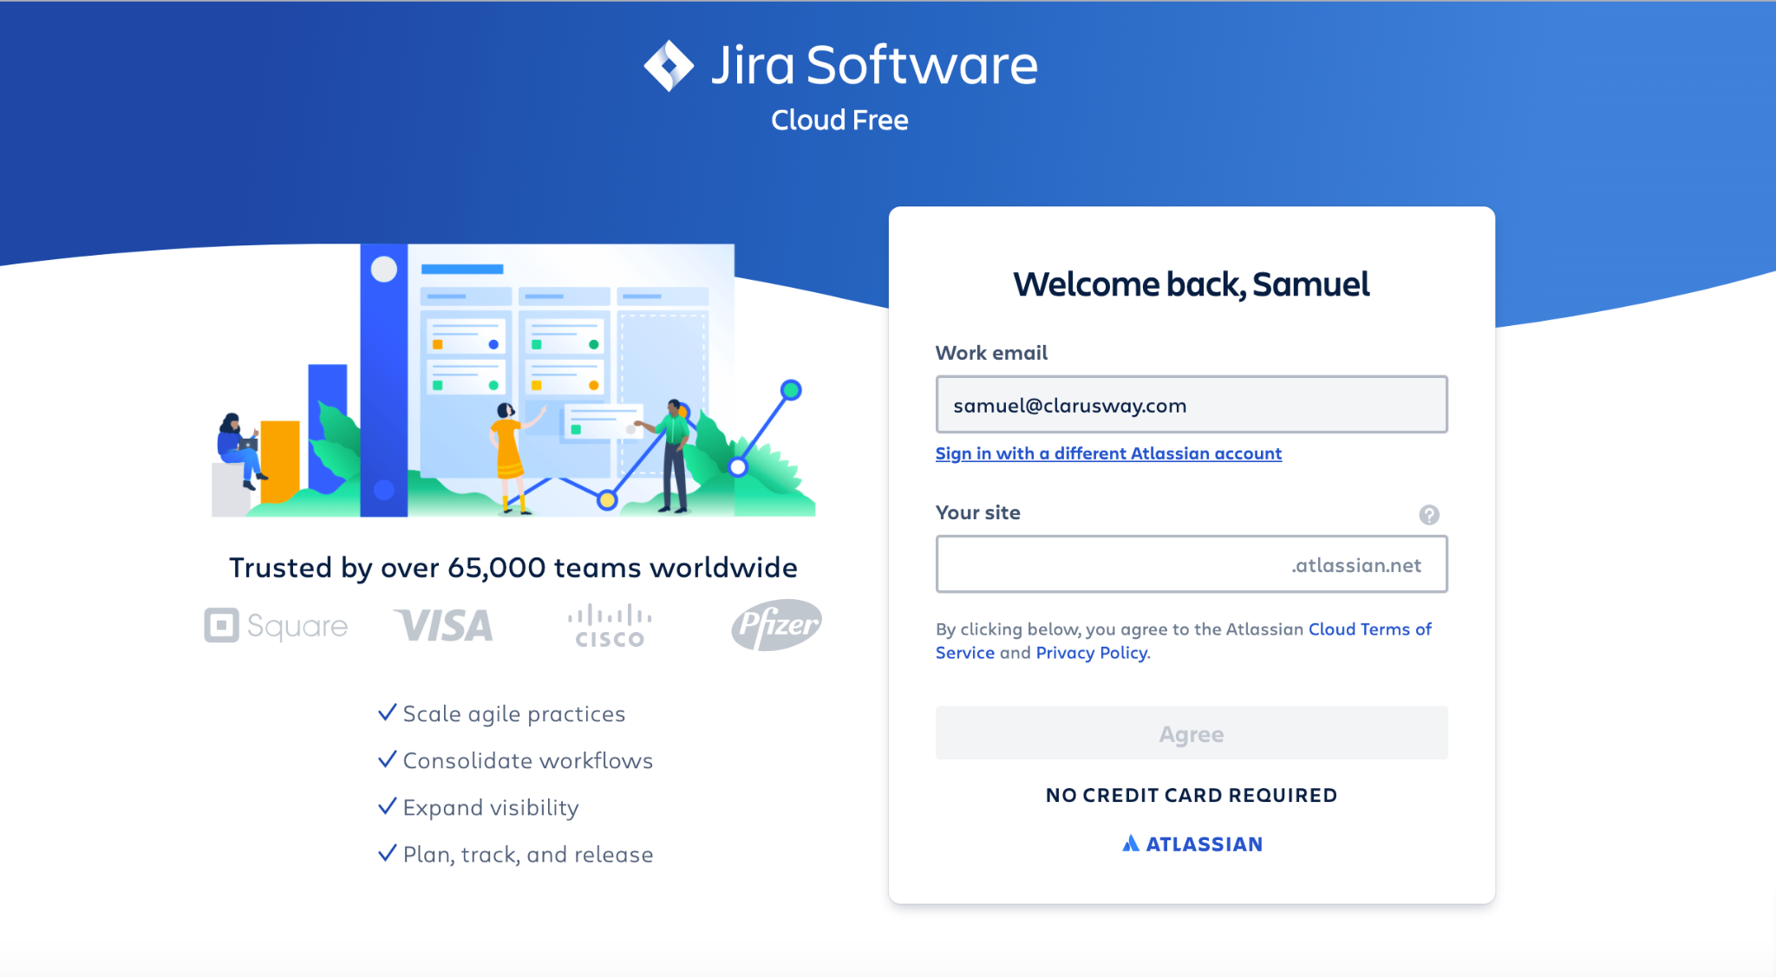
Creating Jira Software Cloud
Notes:
after choosing free option we will this page
now we can create a workspace in jira software cloud.
All your future projects will be stored in this workspace.
This will be your atlassian site.
you should type there a unique name
and than press agree button

Slide 9
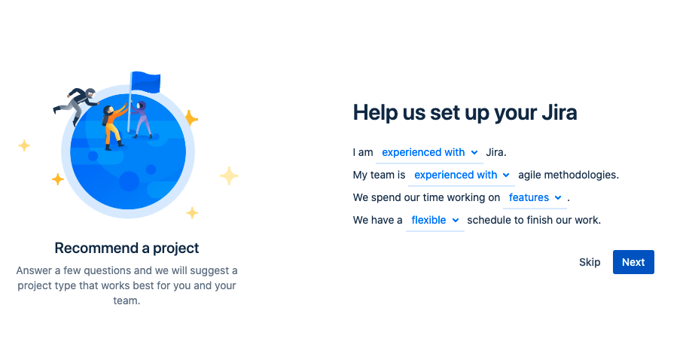
Setting up Jira Software Cloud
Notes:
Here jira will ask you some questions about yourself.
You can skip here, not important

Slide 10
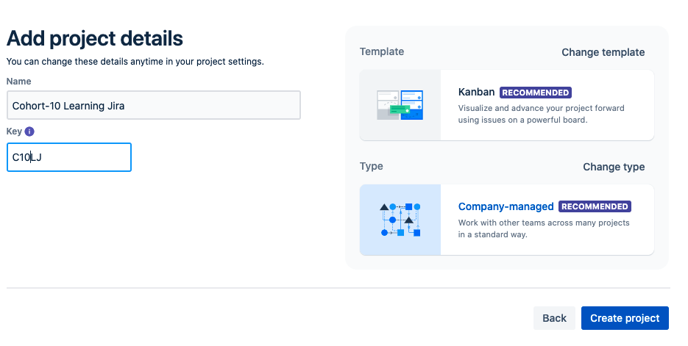
Setting up Jira Software Cloud
Notes:
After that you can add your project name and alias here.
you can remember from last lesson when you write project name
a key automatically generated.
we can create a project as it is recommended by the jira software or
you can change template and type of the management type
First change the template

Slide 11
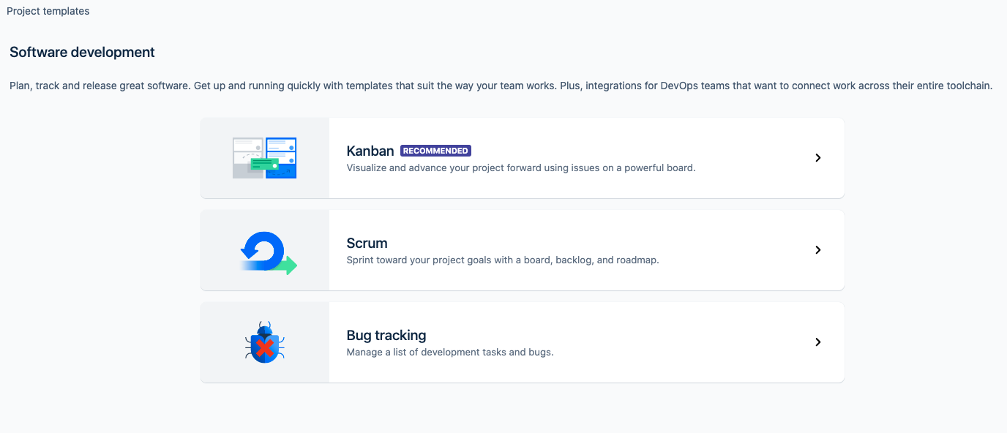
Setting up Jira Software Cloud
Notes:
For project templates there are 3 choices
Kanban- Scrum or Bug tracking
first you can choose scrum

Slide 12
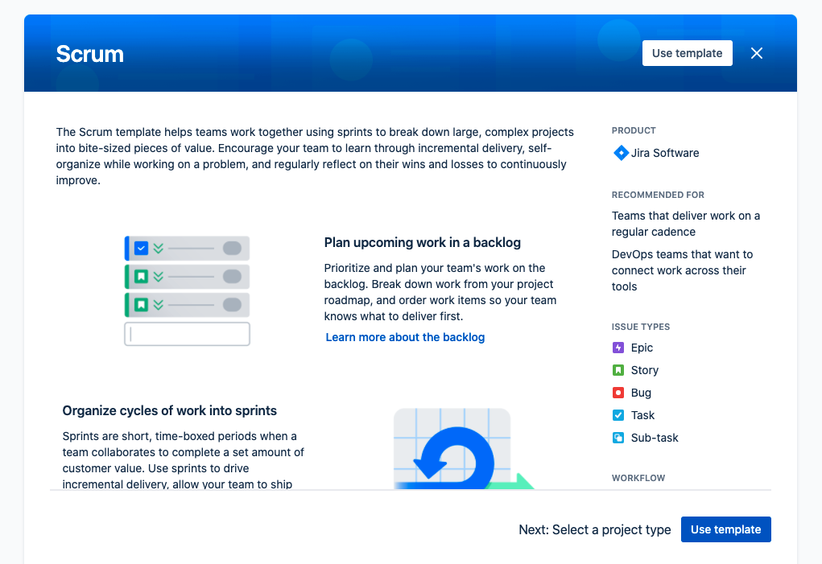
Setting up Jira Software Cloud
Notes:
You will see some information about scrum template
choose “use template”

Slide 13
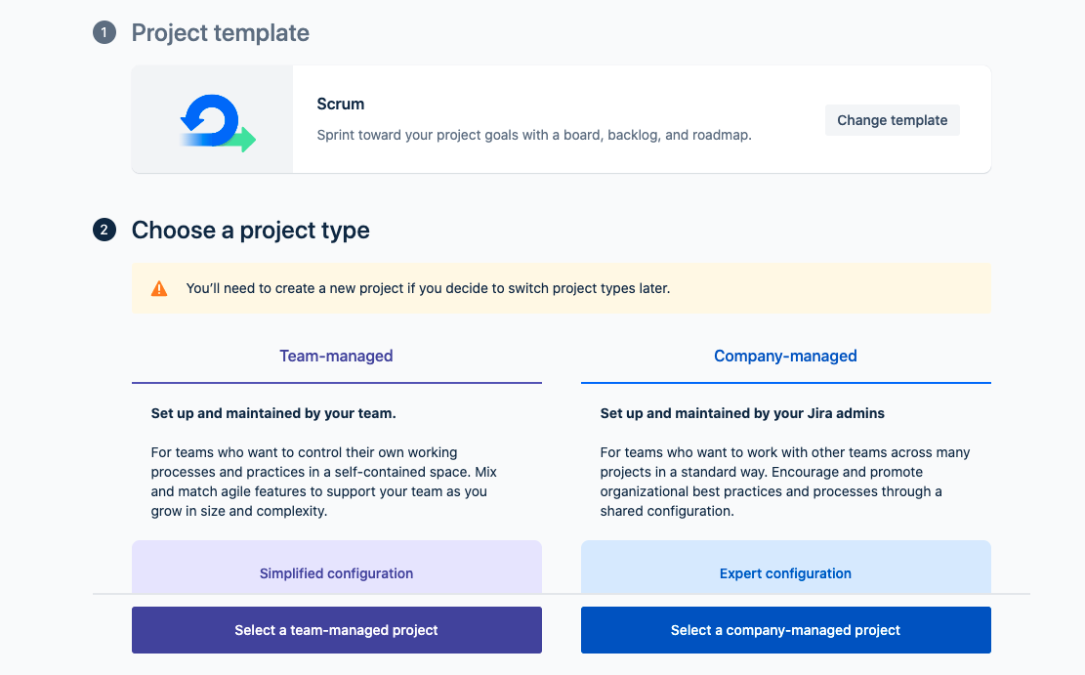
Setting up Jira Software Cloud
Notes:
After this you will see another menu to choose project type.
We will use team managed project from here.
Company managed project type is a little more complicated
You can add versions of issues,
you can deal with more reporting options.
for now we choose team managed projects

Slide 14
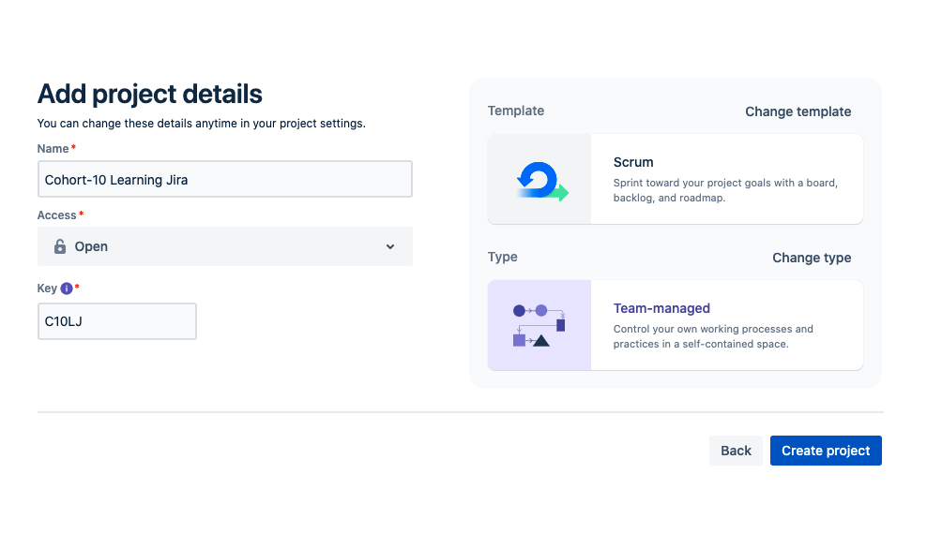
Setting up Jira Software Cloud
Notes:
Now we made all changes
We selected Scrum for template and
team-managed for type.
Ok
Now we can create our project

Slide 15
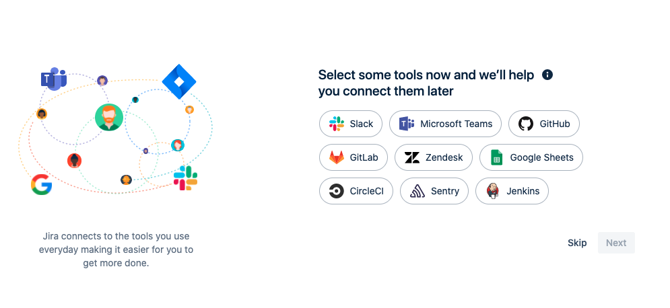
Setting up Jira Software Cloud
Notes:
After that it asks whether we want to make an integration with other tools
you can skip this .
Any time some tools can be integrated to the project.

Slide 16
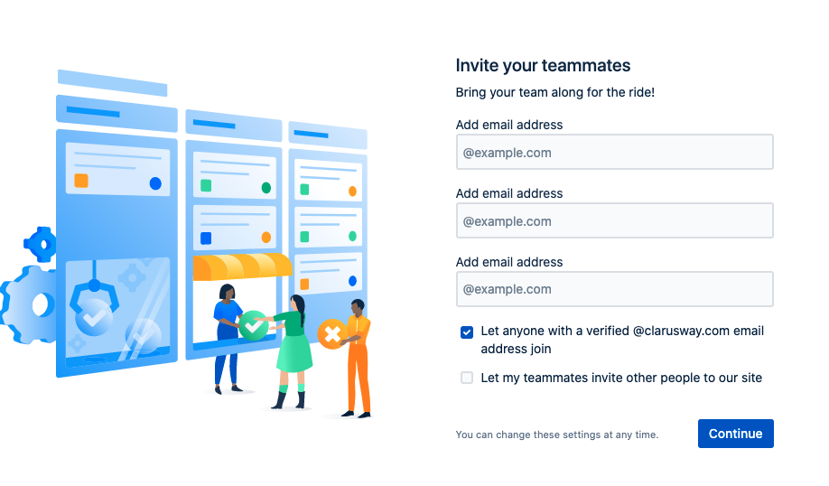
Setting up Jira Software Cloud
Notes:
This is for other team members you want to add to the project.
You can add now or later

Slide 17
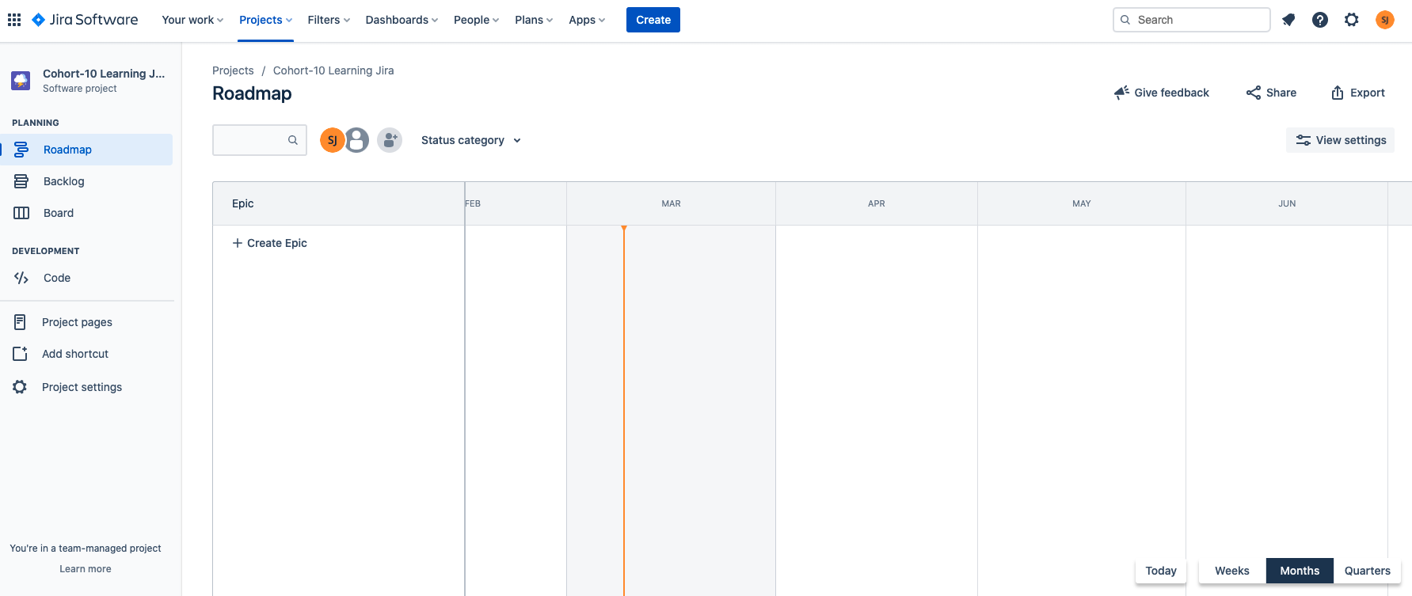
Setting up Jira Software Cloud
Notes:
Here it is
your project board in jira is ready to use
Now I will make it directly from jira
go to atlassian.com and together we will set up our atlassian workspace on jira cloud and
create our first project

Slide 18
Creating Projects
1
Notes:
Now we will learn how to create a project in our jira software workspace.

Slide 19
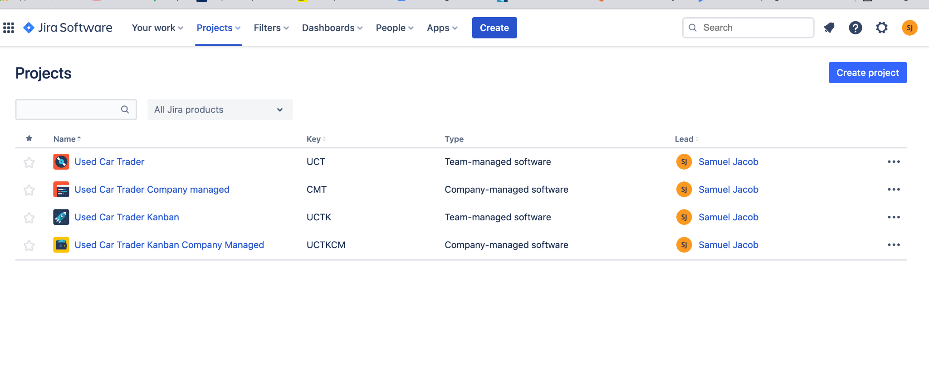
Creating Projects
Notes:
In your board on top menu choose projects .
now you can see which projects you have on your workspace.
Now create a new project
Select Projects > Create project in the navigation bar
or
on the projects page click “create projects” on top right
after that it is the same as we created a project at the beginning.

Slide 20
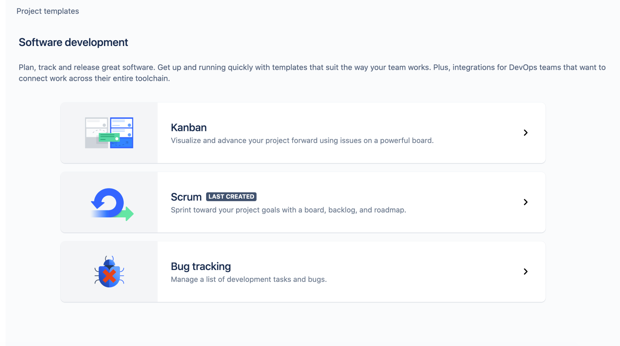
Creating Projects
Project Templates
Notes:
Now I want to explain the difference of project templates when creating a project
Jira Software comes with a variety of project templates
Those templates help teams get set up quickly to a specific purpose of the team or
a specific use.
These templates include pre-configured issue types,
workflows and some other features

Slide 21
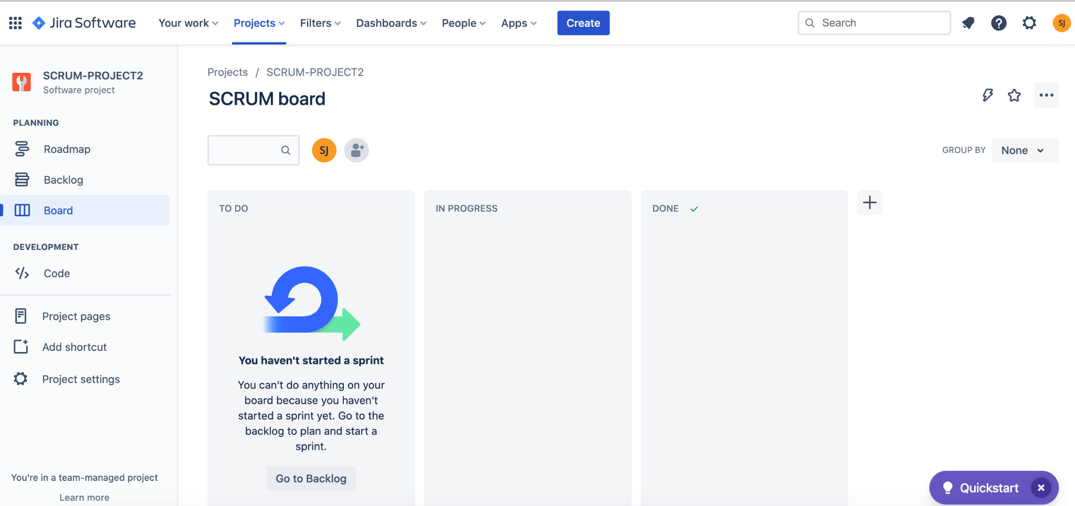
Creating Projects
Project Templates - SCRUM
Notes:
If you chose scrum template your projects will be like this.
Your project comes with with a board, backlog, and roadmap
If your team or company uses scrum methodology with sprints
this template best fits to you
You can Plan upcoming work in a backlog
Organize cycles of work into sprints
and Understand your team’s velocity and capacity with the sprint report and velocity chart

Slide 22
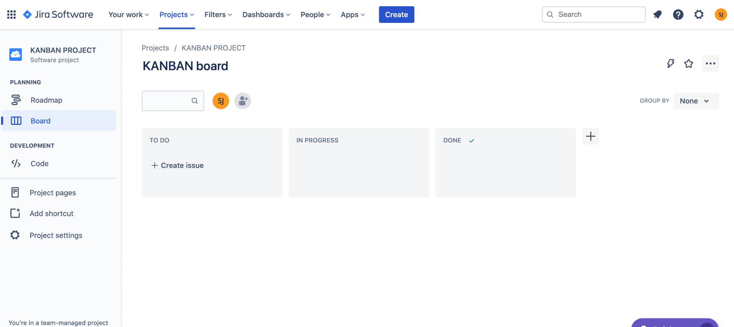
Creating Projects
Project Templates - KANBAN
Notes:
If you chose kanban template your projects will be like this.
Your project comes with with a board and a roadmap
You can Choose the kanban template if your team implements Kanban methodology.
Kanban template helps teams visualize their work,
limit work currently in progress, and maximize efficiency.

Slide 23
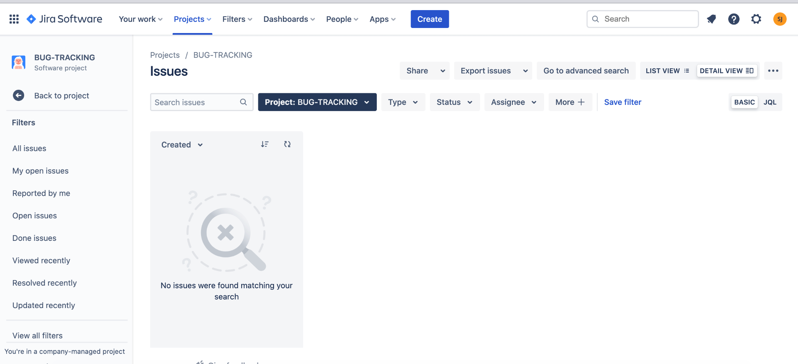
Creating Projects
Project Templates - BUG TRACKING
Notes:
If you chose Bug tracking template your projects will be like this.
Bug tracking manages a list of development tasks and bugs.
It’s best for teams that are capturing, tracking, and resolving bugs.
You can See all your bugs in one place.
Once you’ve identified a bug,
you can capture its details by creating an issue from anywhere in your project.

Slide 24
Creating Projects
Lets Create a Project with Kanban Template
Notes:
We have created a project with scrum template
NOW LETS CREATE TOGETHER A PROJECT WITH KANBAN TEMPLATE
(((go to your jira site, and and create from browser)))

Slide 25

Creating a project also creates a board.
Notes:
🍐 This is a Pear Deck Multiple Choice Slide. Your current options are: A: True, B: False,
🍐 To edit the type of question or choices, go back to the "Ask Students a Question" in the Pear Deck sidebar.

Slide 26


All members of the team can view and use the boards.
Notes:
🍐 This is a Pear Deck Multiple Choice Slide. Your current options are: A: True, B: False,
🍐 To edit the type of question or choices, go back to the "Ask Students a Question" in the Pear Deck sidebar.
true

Slide 27
Project Board
Project Templates - SCRUM
Notes:
Now go to your first project with scrum template
We will talk about scrum board
everybody must see a project board like this.
This is our project board

Slide 28
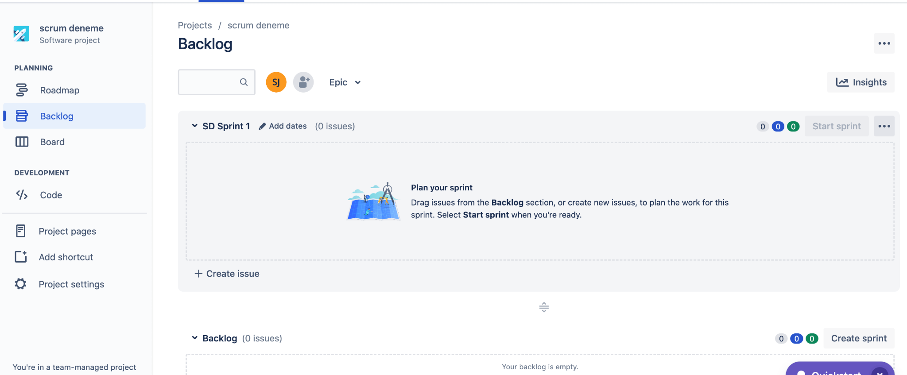
Scrum Backlog
A backlog is a list of issues that can be created for your project.
You can create issues and sprints in the backlog.
Then, you can add issues to a sprint so that your team can work on it.
Notes:
A backlog is a list of issues that can be created for your project.
It is a dedicated space for defining the work of your team
your backlog is where you plan your work to be done in future sprints.

Slide 29
Scrum Backlog
Create Issues and Sprints
A backlog is a list of issues that can be created for your project.
You can create issues and sprints in the backlog.
Then, you can add issues to a sprint so that your team can work on it.
Notes:
You can create issues and sprints in the backlog.
You can add issues to a sprint so that your team can work on it.
The backlog of a Scrum board shows
the issues for your project grouped into a backlog and sprints.
In the Scrum backlog, you can create and update issues,
drag and drop issues, to assign them to sprints,
you can manage epics, and more.
You'd typically use the Scrum backlog when building a backlog of issues,
and planning a sprint.

Slide 30
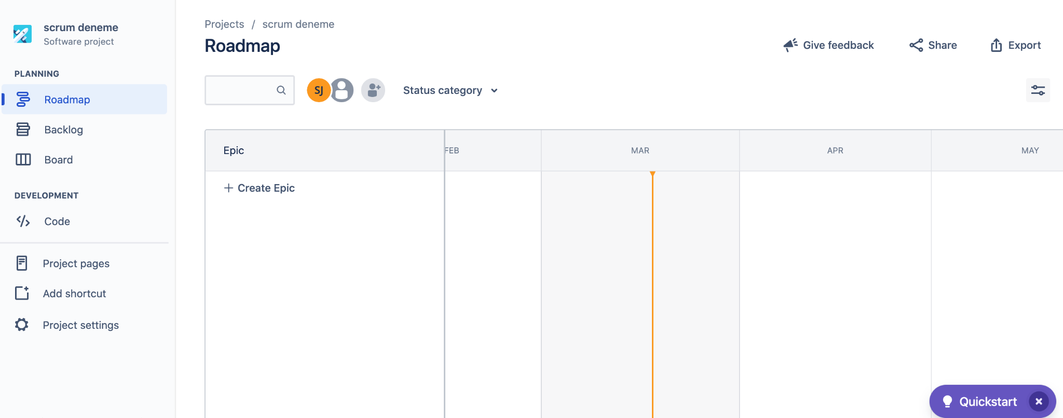
Roadmap
The roadmap view is valuable for creating and planning long-term projects
It visualizes data from your issues
The Timeline section includes timeline bars
Notes:
The roadmap view is valuable for creating and
planning long-term projects.
It visualizes data from your issues
in a Gantt chart so that you can manage your team's work
The Timeline section includes timeline bars
which show how long your tasks scheduled to complete
the roadmap view is a useful tool for planning future work,
but there are limits on what it can show :
Only Parent and Standard issue types show on your roadmap
The default Parent issue type in Jira Software is epic, and the default Standard types are story and task.
An epic-type issue must exist and be included in your project
All issues need to come from one- same project
Your roadmap cannot exceed 3,000 issues

Slide 31
Roadmap
The roadmap view is valuable for creating and planning long-term projects
It visualizes data from your issues
The Timeline section includes timeline bars
Notes:
The roadmap view uses your project’s board as its issue source.
As you create issues in your project, they're automatically added to your roadmap
.
You can also make new issues directly on your roadmap view.
You can create epic and under epic you can create stories and tasks

Slide 32
Introduction to Issues
2
Notes:
A general review of creating a Project will be displayed.
Issues are the packets of work that need to be completed in a project.
Issues are the core of the Jira applications because all the team collaboration happens around issues

Slide 33
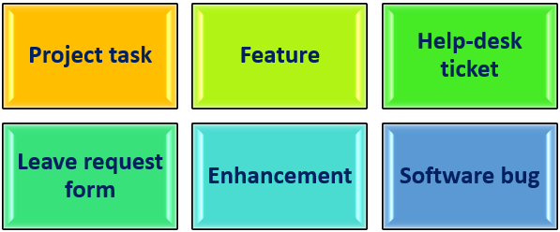
What is an Issue?
In Jira, teams use issues to track individual pieces of work that must be completed.
Notes:
Issue types are different types of work in unique ways,
try help you identify, categorize, and report on your team's work across your Jira site.
They can help your team build more structure into your working process
.Each Jira product comes with default issue types to suit the needs of your projects and teams.

Slide 34
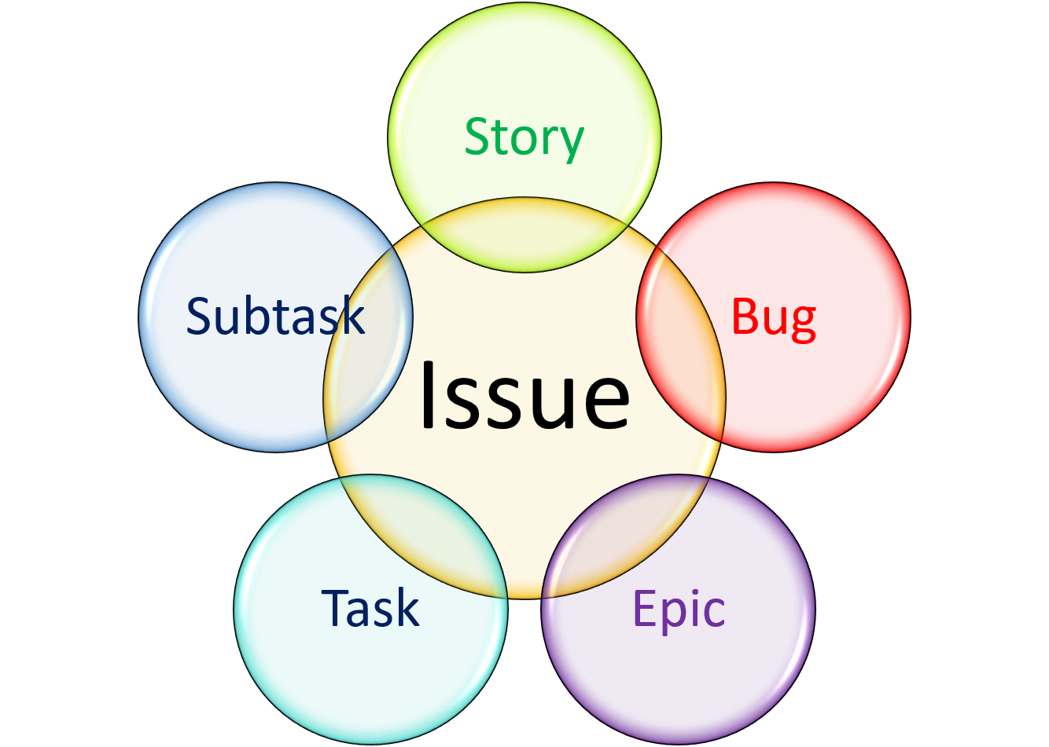
Issue Types
Epic : An epic is a set of jobs that can be divided into manageable user stories.
Story : A story is a short requirement written from an end-user perspective.
Task : A task represents the job that needs to be done.
Bug : A bug impairs expected functionality of the product.
Subtask: A subtask can be considered as a smaller piece of a standard issues.
Notes:
By default, Jira supports three levels of hierarchy:
Epic issues, which represent high-level and bigger pieces of work in Jira.
Standard issues represent regular business tasks. Story task and bug are standart issues
In Jira, standard issues are where daily work is discussed and carried out by team members.
Subtask issues, which can help your team break a standard issue into smaller chunks.
This can be helpful if your team has a task that requires multiple people working on it,

Slide 35
Issue Types
Epic
Story
Task
Bug
Subtask
Notes:
Parent and child are terms that describe a type of relationship between issues:
A parent issue is an issue that sits above another issue
A child issue is an issue that sits below another issue
This means that the parent and child relationship isn’t limited to specific issue types.
Rather, any issue type can be both a parent and a child issue —
the only exception is subtasks,
subtask can only be a child because there aren’t any issue types below it in the hierarchy.
For example, if you have this issue hierarchy:
Epic
Story, Task, Bug
Subtask
Then:
As a parent issue, an epic can have stories, tasks, and bugs as child issues.
As a parent issue, a story, task or bug can have subtasks as child issues.
A subtask can’t have any child issues.

Slide 36
Which statement is correct?
Notes:
🍐 This is a Pear Deck Multiple Choice Slide. Your current options are: A: There are often multiple stories in an epic., B: There are often multiple epics in a story.,
🍐 To edit the type of question or choices, go back to the "Ask Students a Question" in the Pear Deck sidebar.

Slide 37
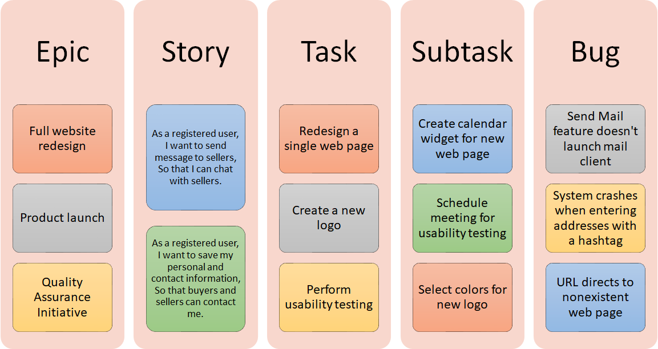
Examples for Issue Types
Notes:
Here you can see some issue type samples

Slide 38
A project in Jira Software manages a collection of what .
Notes:
🍐 This is a Pear Deck Multiple Choice Slide. Your current options are: A: users, B: development plans, C: issues, D: permissions,
🍐 To edit the type of question or choices, go back to the "Ask Students a Question" in the Pear Deck sidebar.

Slide 39
Issue Fields
Field | Description
Issue type | The issue types you can define in Jira Software are Story, Task, Bug, and Epic.
Summary | This field is marked with an asterisk, so you have to write a summary to create an issue.
Description | This field is where you write a description of your issue.
Fix versions | This field is used to indicate the future version in which the issue is resolved.
Labels | This field can be considered as a tag or keywords.
Environment | This field describes the environment of the issue.
Attachment | You can attach files to this field from your local drive or cloud storage provider.
Affects versions | This field describes in which version the bug exists.
Linked Issues | Using this field, you can link issues in your project.
Priority | This field describes the priority of the issue.
Assignee | This field represents the user who the issue is assigned to.
Epic Link | This field is a relational link to identify the parent epic of the issue.
Sprint | This field is used to add the issue to the sprint that you want to associate with.
Notes:
issues are made up of issue fields,
and the issue fields contain data about the issue.
This data is important,
as it helps define the issue, and can contain important information about the issue,
such as a summary, a description, due dates,

Slide 40
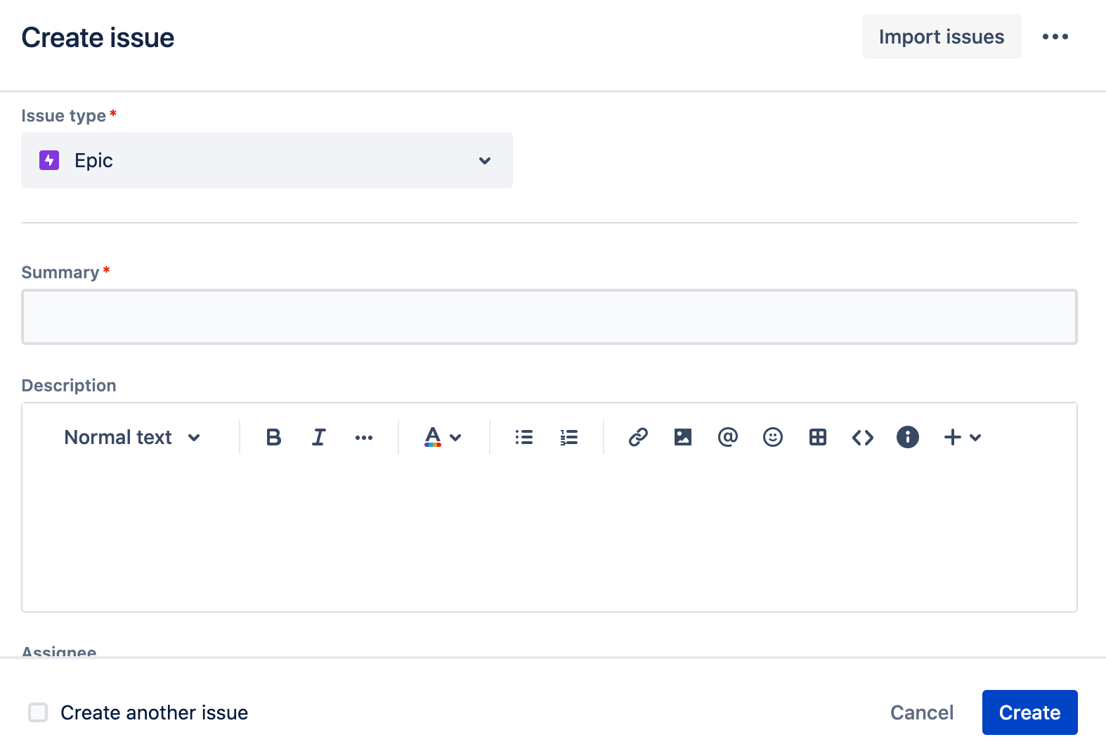
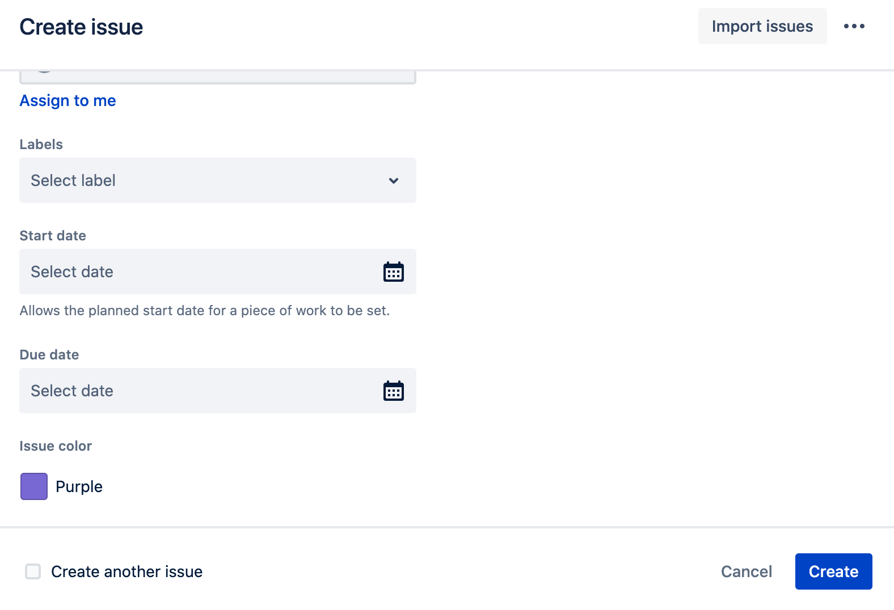
Issue Fields
Notes:
You can:
Change a field's behavior
(such as change a field's description, make a field hidden or visible,).
>>(show from create issue button)<<

Slide 41
Board Columns represent the underlying workflow.
Notes:
🍐 This is a Pear Deck Multiple Choice Slide. Your current options are: A: True, B: False,
🍐 To edit the type of question or choices, go back to the "Ask Students a Question" in the Pear Deck sidebar.

Slide 42
Working with Issues
3
Notes:
Now it is time to make our hands dirty.
We will create epics, stories and tasks together
So far We have created a project but it is empty.
Now we will fill it with some issues.

Slide 43
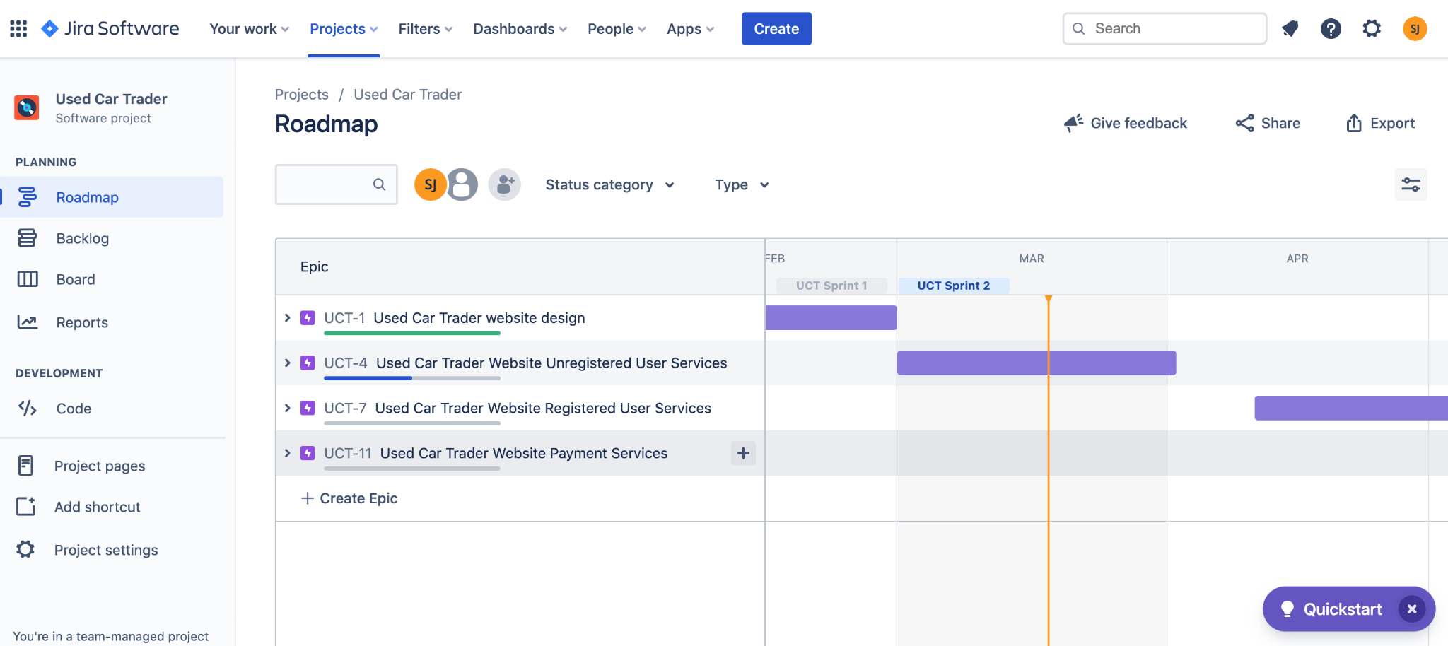

Creating Epics From the Roadmap View
Notes:
Now we are starting to plan our project.
First we will create epics
We can create epics from Roadmap view and also from Backlog view.
First lets create some of the epics from Roadmap
I will write the epics from class chat and we all create them in our jira software
Now go to roadmap.
Epics:
Used Car Trader website design
Used Car Trader Website Unregistered User Services

Slide 44
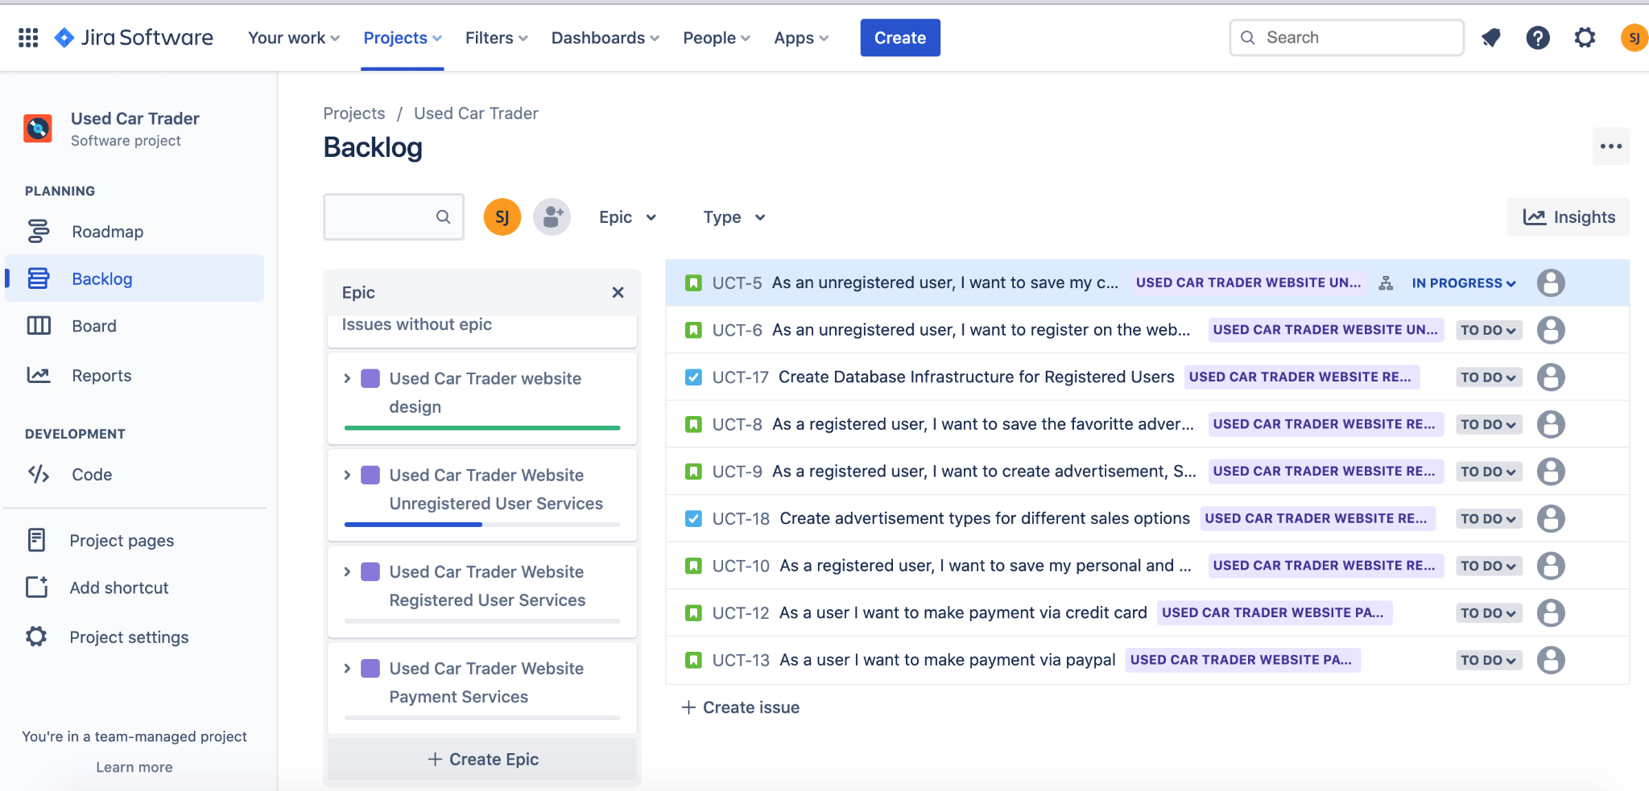

Creating Epics From the Backlog View
Notes:
Second way to create epics is from backlog view.
Normally you can not see epics in your backlog because
backlog is a list of “to do’s”. So only user stories and tasks are on the backlog.
But you can also choose to see epics on backlog view.
First go to epic button here. And choose to see “Epic Panel”
Lets create some epics from here.
Epics:
Used Car Trader Website Registered User Services
Used Car Trader Website Payment Services

Slide 45
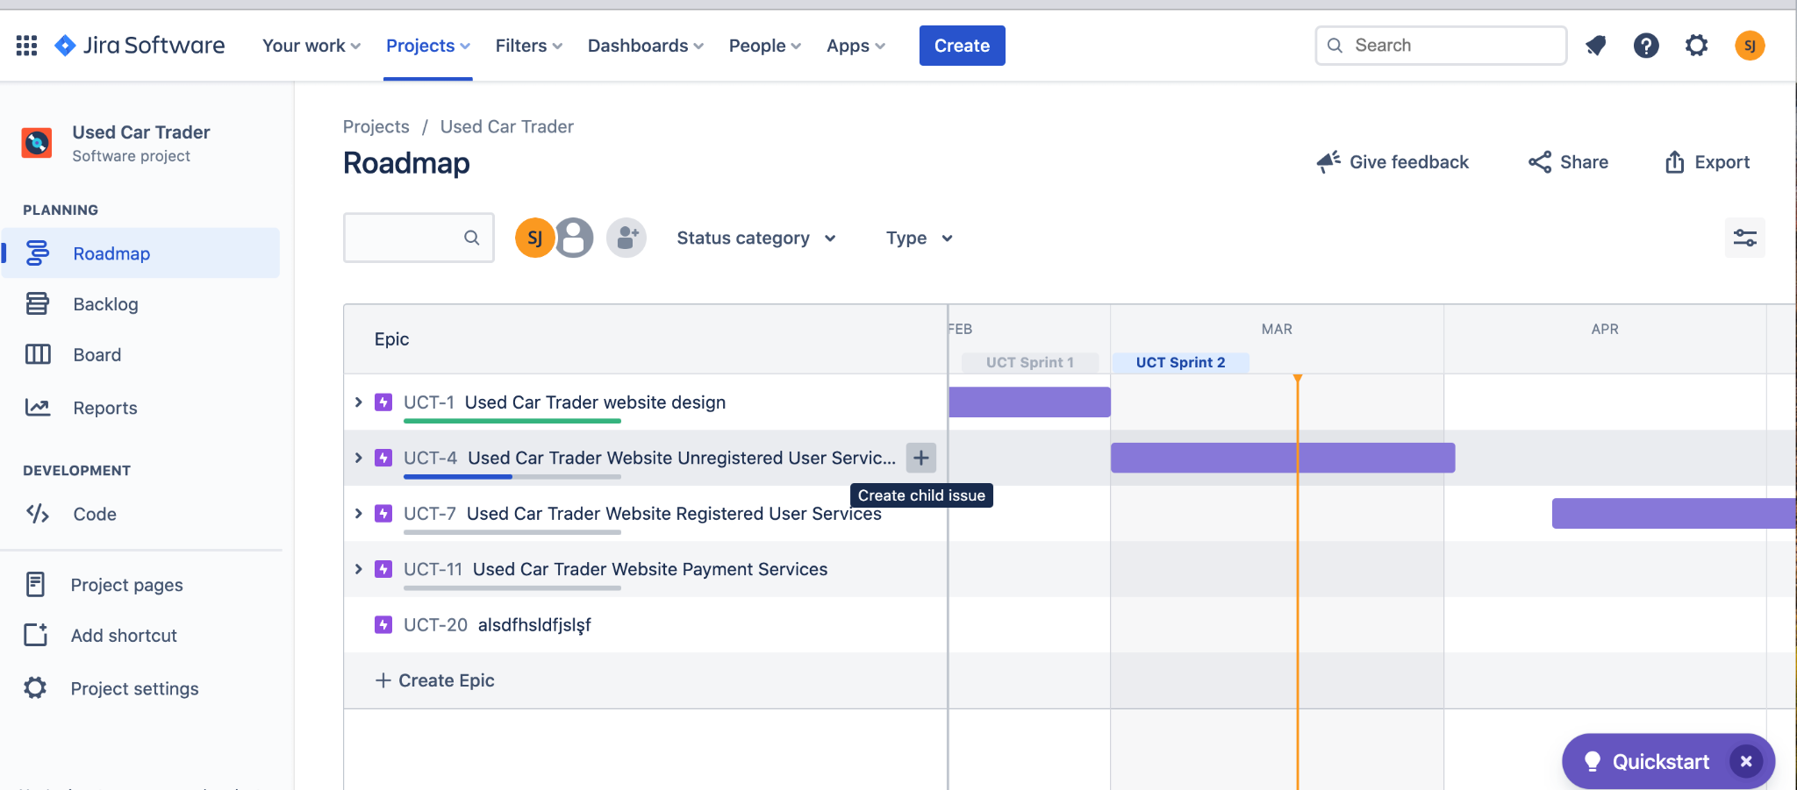
Creating Story From the Roadmap View
Notes:
Now we will create stories and tasks
One option to create a user story or a task is
creating it from Roadmap view directly under an epic
Create this user story under the first epic:
As a user I want to navigate my settings from landing pages that it will be easy to log in
we can also create tasks
Now lets create a task again under first epic::
Create Template in Figma
Prepare Frontend Structure Pseudo Code
Create a new logo

Slide 46
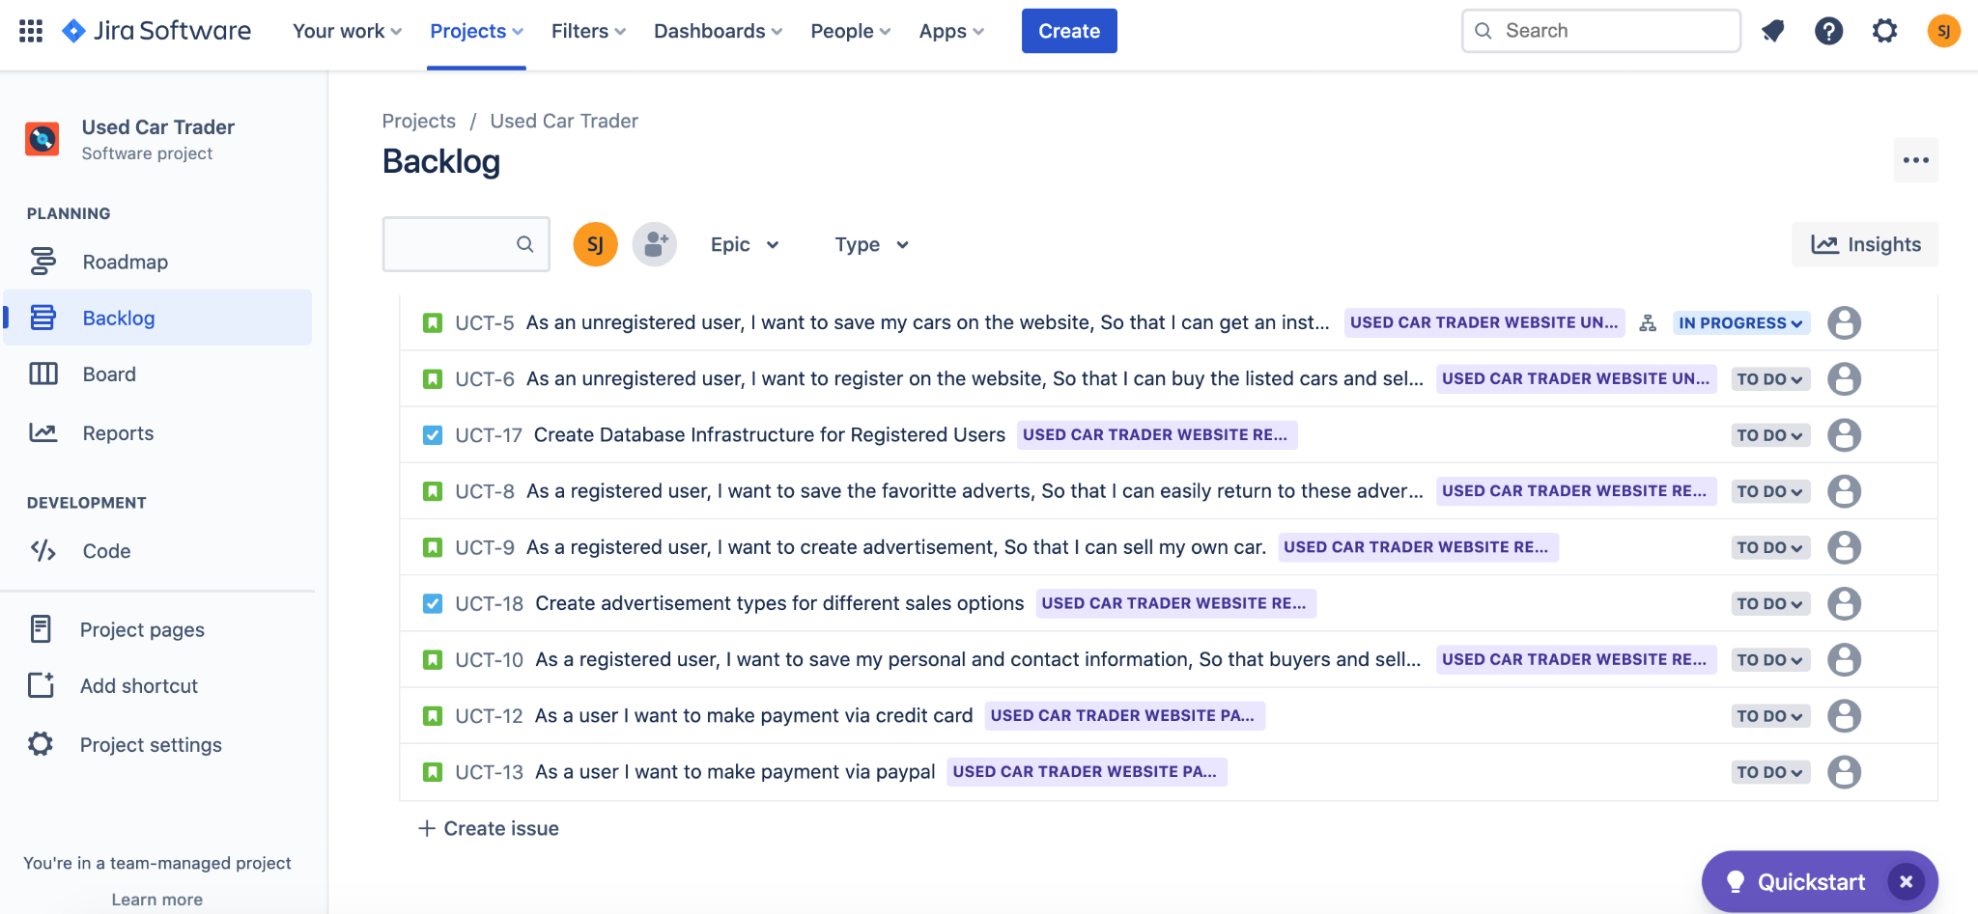
Creating Story From the Backlog View
Notes:
The second option to create a user story or a task is
creating it from Board view directly in your backlog list
By default it creates story when you click “create Issue” button
But you can change it
Now Create some User stories::
( epic : Used Car Trader Website Unregistered User Services)
As an unregistered user, I want to register on the website, So that I can buy the listed cars and sell my own car.
As a registered user, I want to save my cars on the website, So that I can get an instant valuation.
As a registered user, I want to save the favorite adverts, So that I can easily return to these adverts later.
Now lets create a task::
Perform usability testing for registered user module

Slide 47
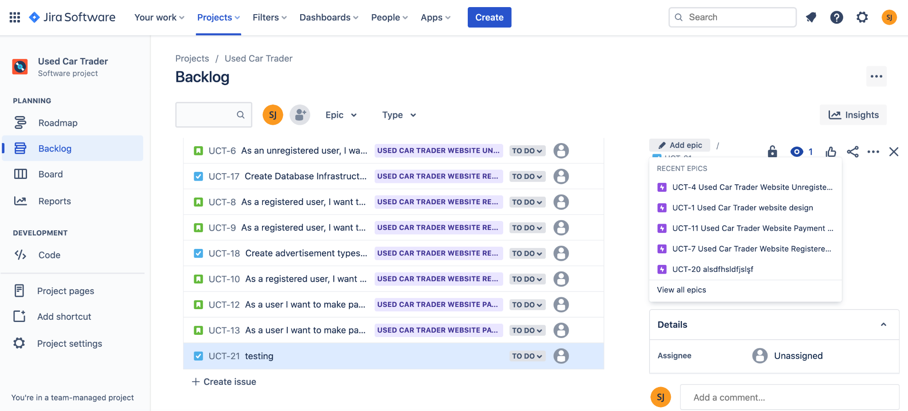

Adding a Story or Task to An Epic
Notes:
We can add stories and tasks to an epic.
First click on top of an issue
on the right side Issue panel will open
At top there is a epic button click on it and choose the epic you want to add

Slide 48
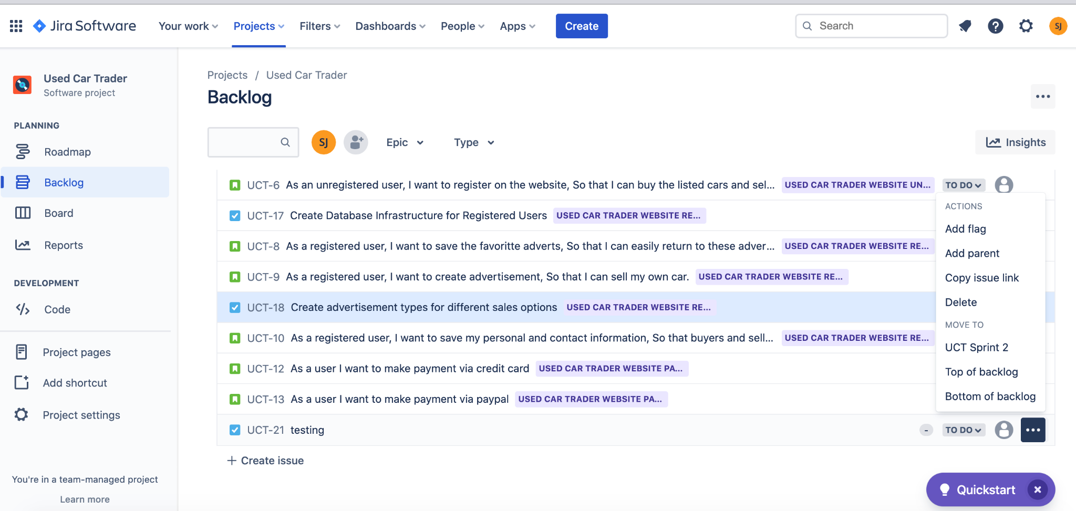
Adding a Story or Task to An Epic
Notes:
There is one more option to add the stories and tasks to an epic
There is a menu button right side of the issues.
Click on it
and click on “Add Parent” button

Slide 49
Creating Bug

Slide 50
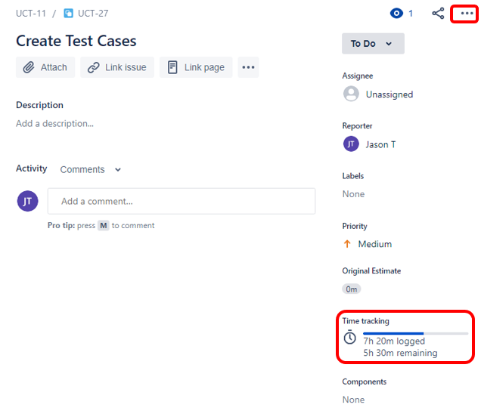
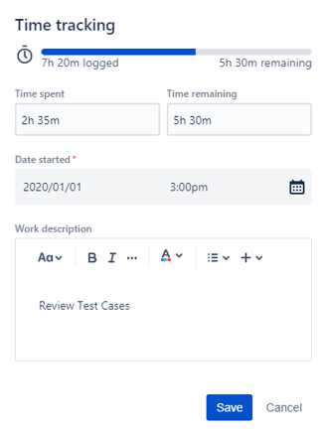
Logging Time on Issues

Slide 51
Planning Sprints
4

Slide 52
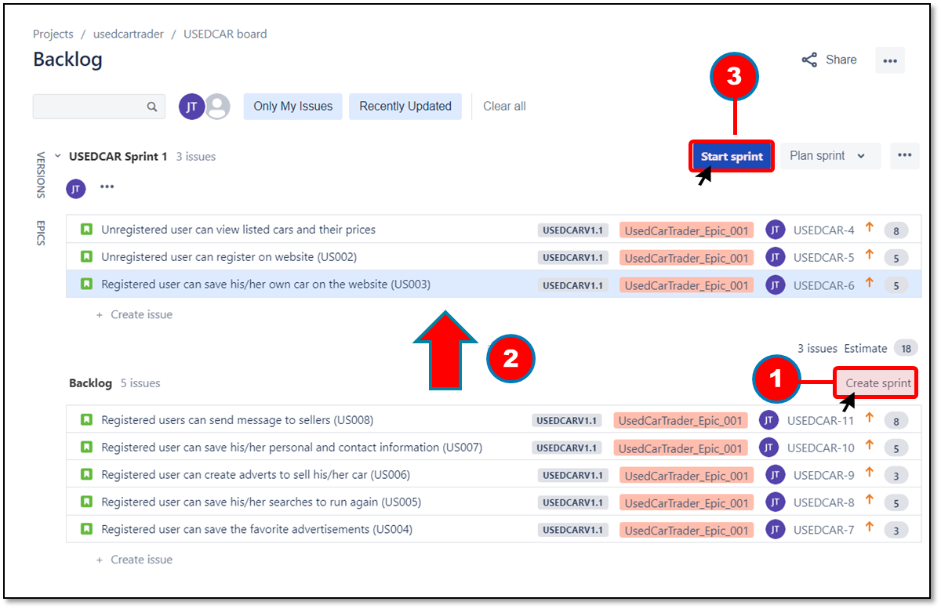
Starting Sprint
Click on ‘Create Sprint’
Drag and Drop
Click on ‘Start Sprint’

Slide 53
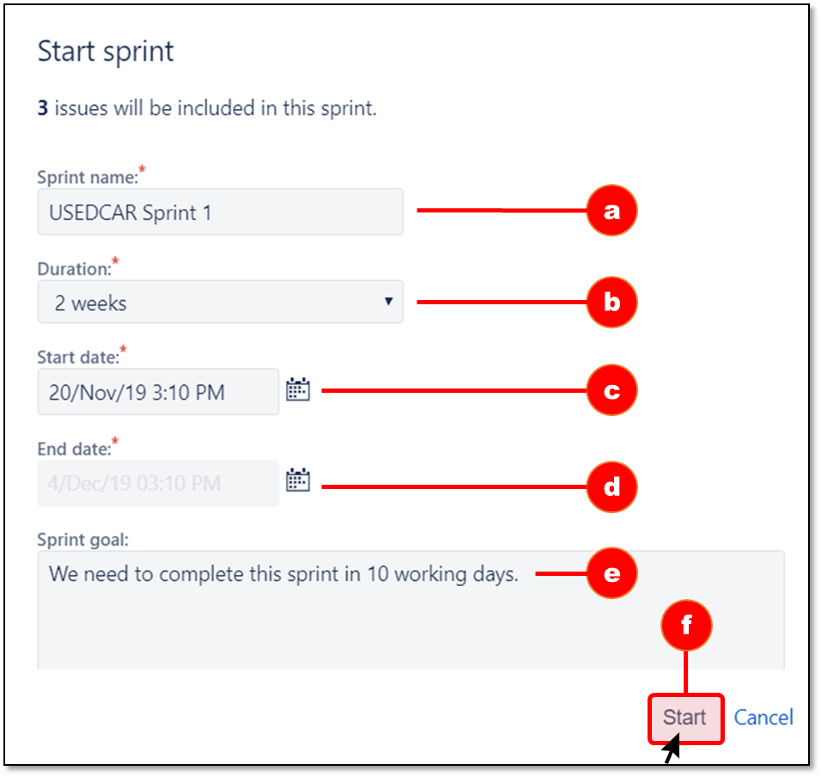
Starting Sprint
Provide a name for the sprint
Set the duration of the sprint
Set the start date
See the end date auto-updated
Provide the sprint goal
Click on the Start button

Slide 54
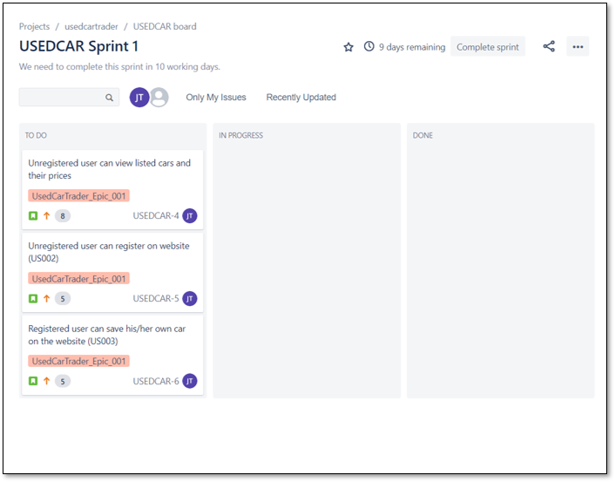

Working with Sprint

Slide 55
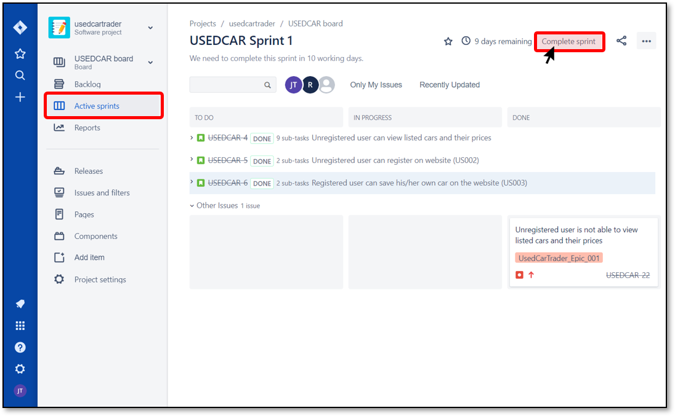
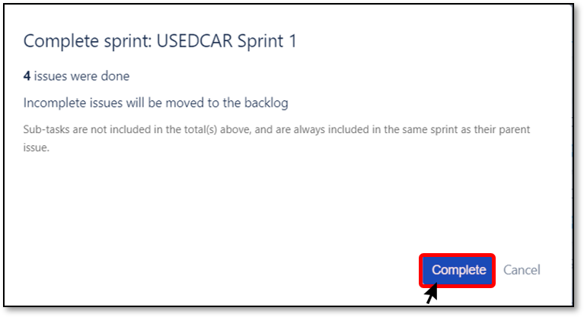
Completing Sprint
Click on ‘Complete Sprint’
Click on ‘Complete’

Slide 56
Reports in Jira
5

Slide 57
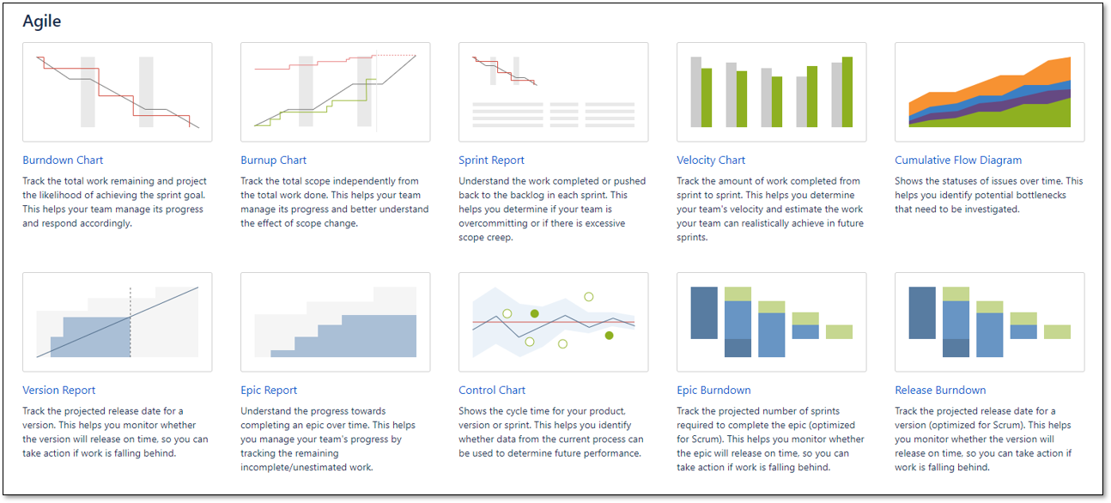
Agile Reports

Slide 58
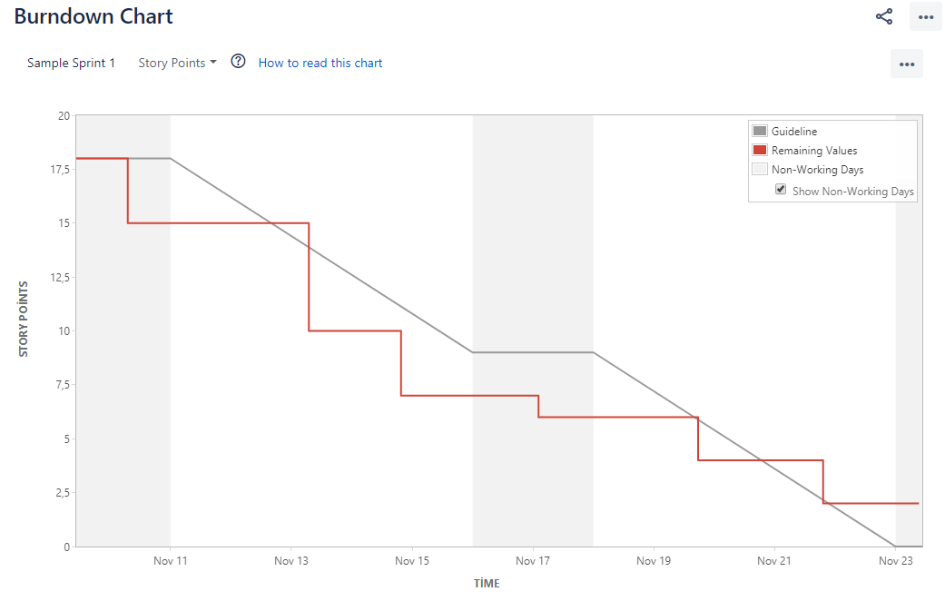
Burndown Chart
Actual and estimated work
Track sprint progress
Identify problems
Past and present performance
Likelihood achieving sprint goal
Estimated Burndown Line
Work
Actual Burndown Line
Time
Nonworking Days

Slide 59
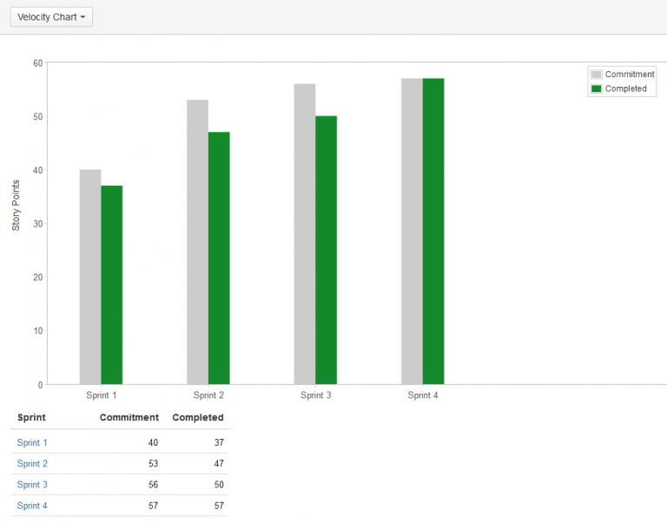
Velocity Chart
Shows estimates versus actual work completed
Helps predict future performance
Identify trends in commitments & delivery
Useful for sprint planning to determine scope
Total Estimated Work
Total Completed Work

Slide 60
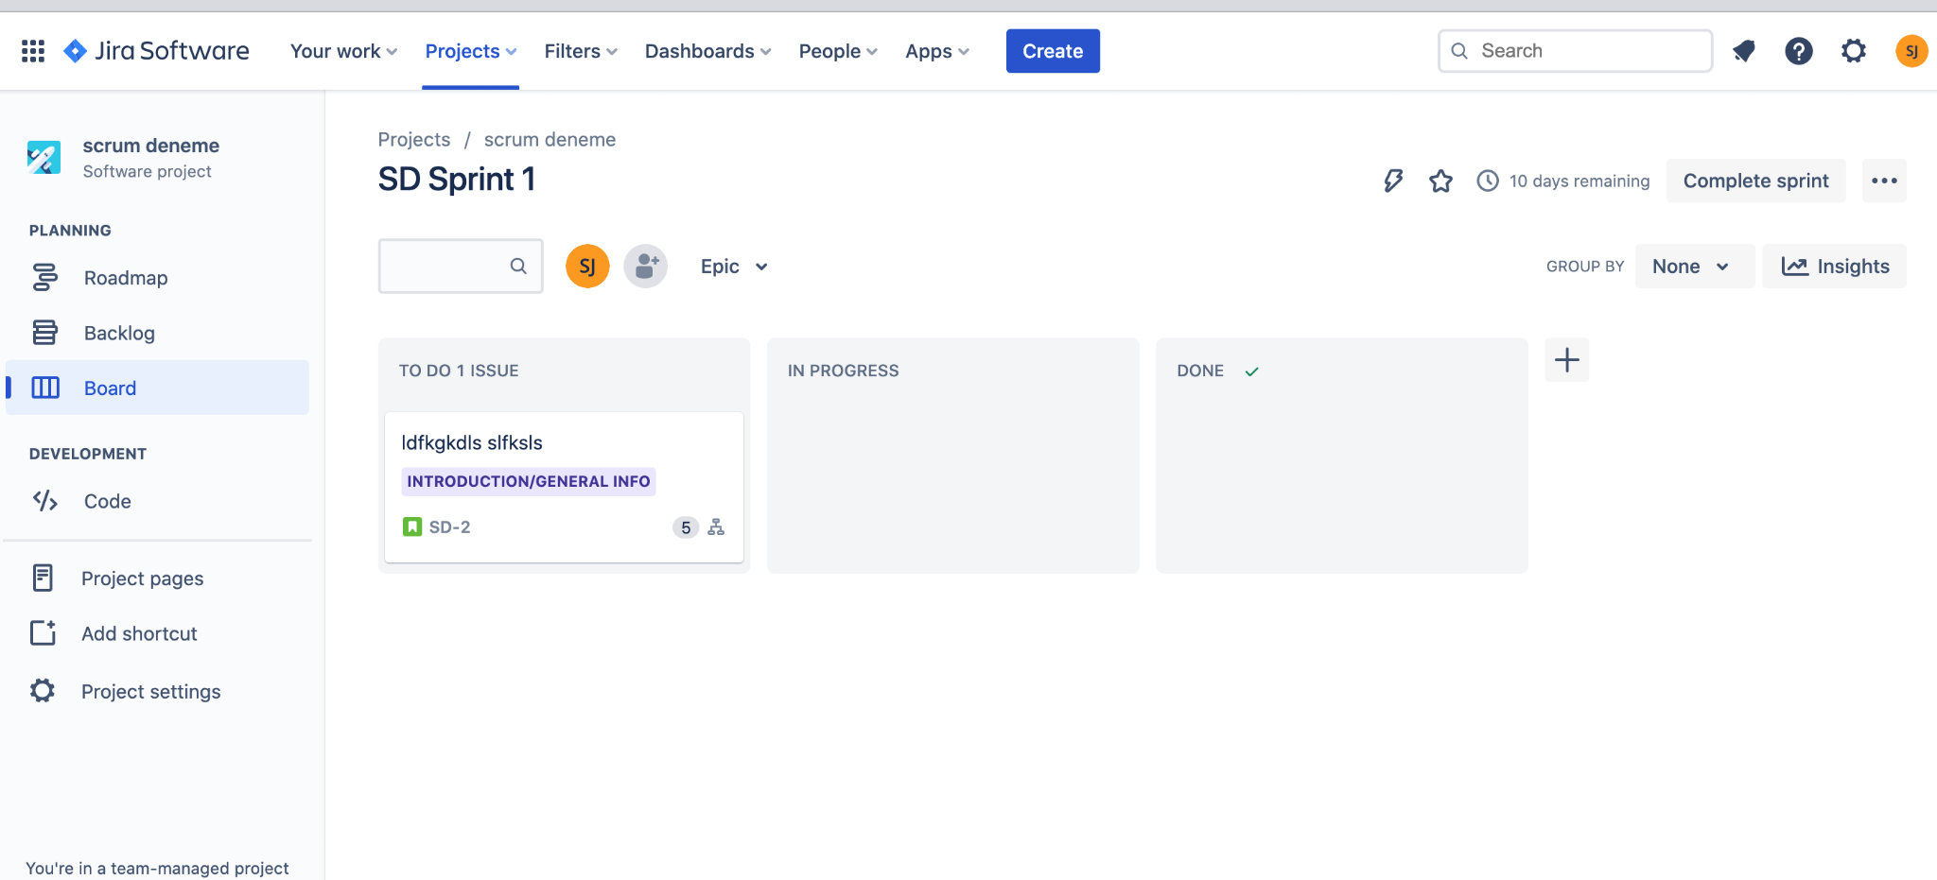
Adding Reports

Slide 61
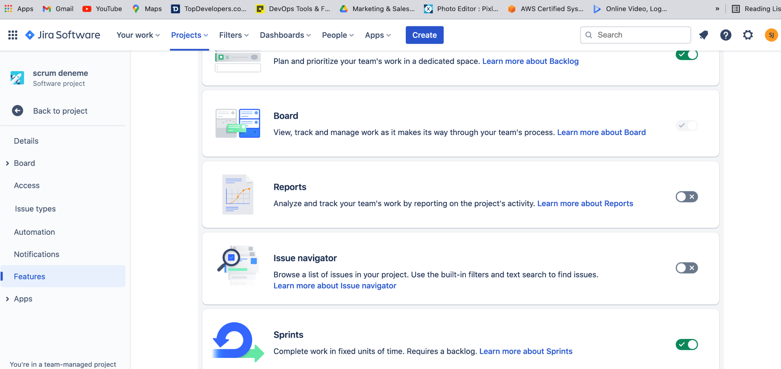
Adding Reports

Slide 62
Which report is an answer to this question?
How many story points left to cover in the sprint?
Notes:
🍐 This is a Pear Deck Multiple Choice Slide. Your current options are: A: Velocity Chart, B: Burndown Chart, C: Sprint Report,
🍐 To edit the type of question or choices, go back to the "Ask Students a Question" in the Pear Deck sidebar.

Slide 63


Slide 64

THANKS!
Any questions?
You can find me at:
@volkan - Instructor
volkan@clarusway.com

